Slide 1
RSA-Project Presentation
Managing traffic on emergency vehicles trips
Hugo Domingos 98502
Cláudio Asensio 98433

Slide 2
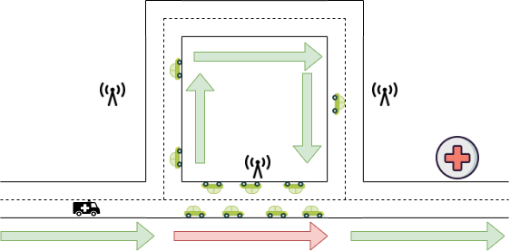
Objectives
Develop a system to warn vehicles that an emergency vehicle is approaching and help deciding the faster and safer path to the hospital
RSUs along the way are used to spread the message to emergency vehicle
Use of CAMs, DENMs and SPATEMs to help the emergency vehicle to reach the destination faster and safety

Slide 3
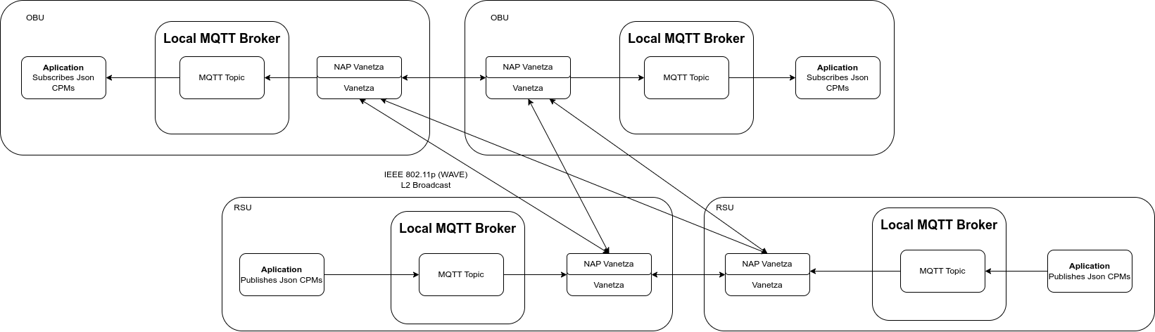
Architecture
The network has 6 OBUs and 4 RSUs.

Slide 4
What was implemented
Range between OBUs is simulated
One RSU computes the distance between each pair of OBUs
RSUs are resending the information from the cars to reach to the emergency vehicle when is out of range
Emergency vehicle computes the best path based on a punctuation with two factors:
Total distance
Number of cars on the way
Normal cars pull over when receiving DENM from emergency vehicle
RSUs are reacting to the DENM messages
Sends SPATEM messages to let the emergency vehicle go through and block the other traffic

Slide 5
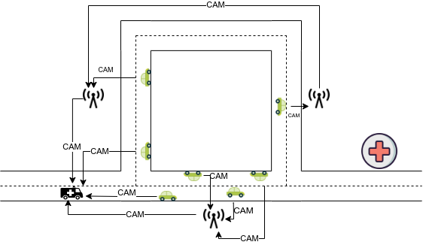
CAM
CAMs are sent periodically with information such as
Coordinates
Station type
CAMs are resent by the RSUs so that the ambulance knows the location of every car
Used by the ambulance to know where each car is
This way can compute on many cars are on each possible path

Slide 6
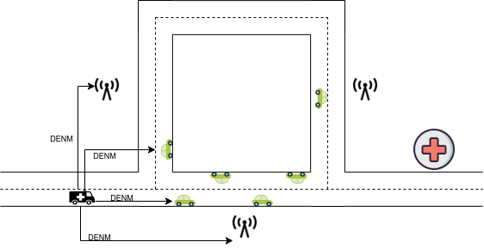
DENM
Emergency vehicle starts to send DENM messages
To warn nearby cars of its presence
Cars pull over to let the emergency vehicle go through
DENMS are sent with
causeCode = 95
subCauseCode = 1
the emergency vehicle is approaching
Notes:
The ambulance is generating DENMS with causeCode 95 and subCauseCode 1 which means, that an emergency vehicle sent the message and that the vehicle is approaching.

Slide 7
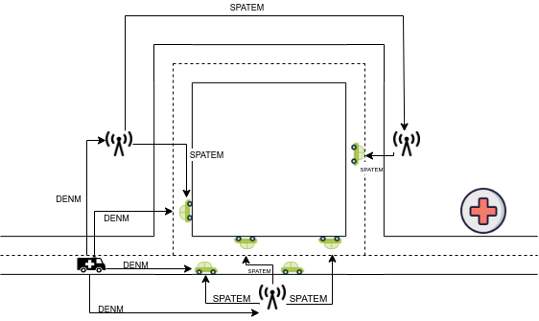
SPATEM
SPATEMs are sent by the RSU
When receives DENM from emergency vehicle
Used to give priority to the ambulance in a safer way
Traffic from the street where the ambulance at, is allowed to move.
Cars on other streets are blocked.

Slide 8
Timeline
Emergency vehicle (OBU) starts on the incident location.
The normal cars are sending CAMs.
It gathers the information received by the cars and the RSUs and starts moving forward to the hospital.
On each intersection the emergency vehicle computes the best path based on the total distance and the number of cars on the way.
The normal cars are warned that the emergency vehicle is nearby with DENMs sent by the emergency vehicle.
The normal cars pull over to let the emergency vehicle go through.
The RSUs send SPATEM messages, when receiving DENMs from the emergency vehicle, to change the traffic lights.
The simulation ends when the emergency vehicle arrives to the hospital.

Slide 9
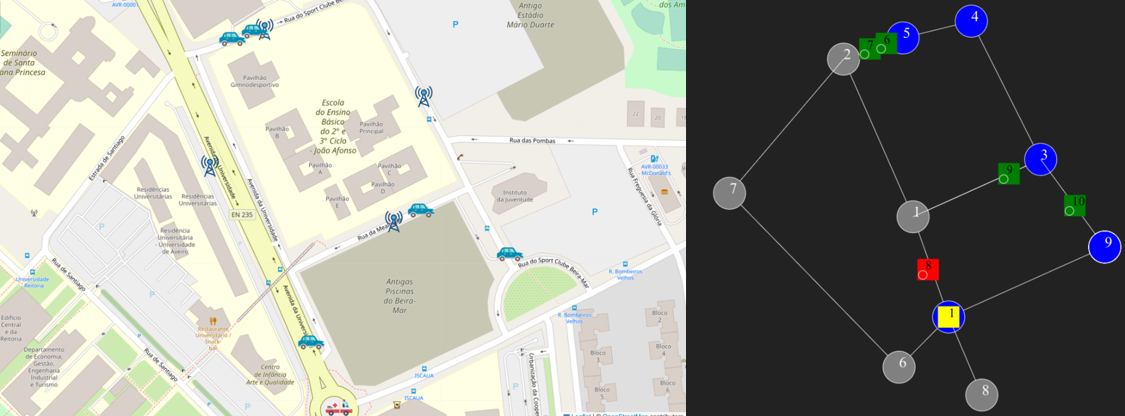
Timeline

Slide 10
Live Demo

